Slide 1


Lesson 11 Tara’s birthday party
UNIT 3

Slide 2
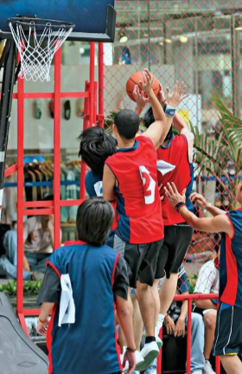

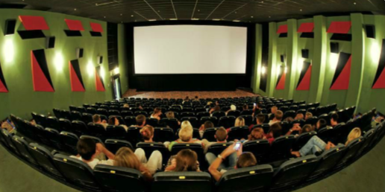
Answer the questions about your weekend. Remember to use Past Simple! How was your weekend? Where were you? Were you at home?

Slide 3
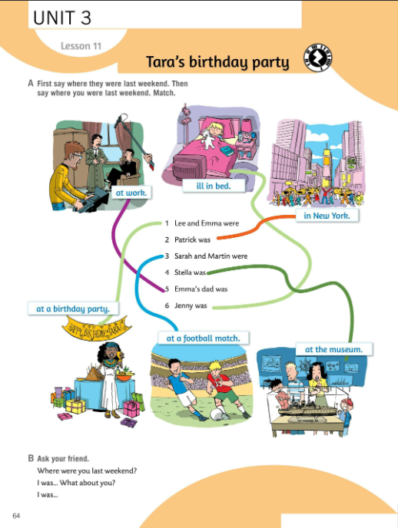
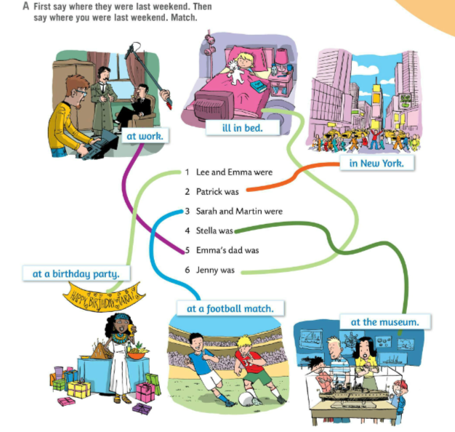
Look at the pictures in Task A. Where were they last weekend? Say.
e.g. Lee and Emma were at a birthday party last weekend.
Write the sentences.
1 Lee and Emma were at a birthday party.
2 Patrick was in New York.
3 Sarah and Martin were at a football match.
4 Stella was at the museum.
5 Emma’s dad was at work.
6 Jenny was ill in bed.
Ask your friend questions about his/her weekend.

Slide 4
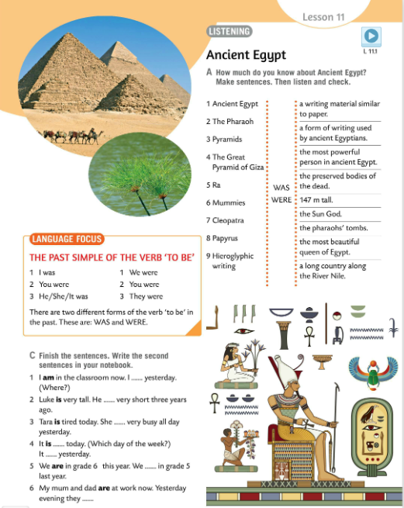
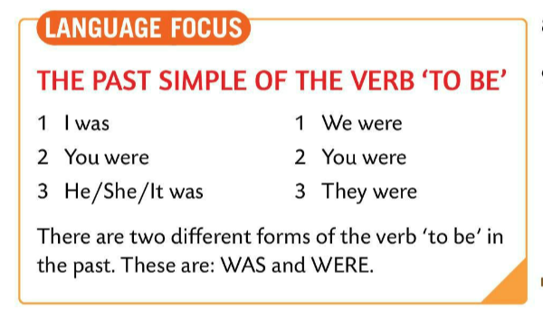
LANGUAGE FOCUS
THE PAST SIMPLE OF THE VERB ‘TO BE’
Past simple is used to describe events that happened at the specific time in the past and finished in the past.
Glagolsko vrijeme past simple koristimo kako bismo opisali događaje koji su se dogodili u određeno vrijeme u prošlosti i koji su završili u prošlosti.
Copy.
singular plural
I was We were
You were You were
He/She/It was They were

Slide 5
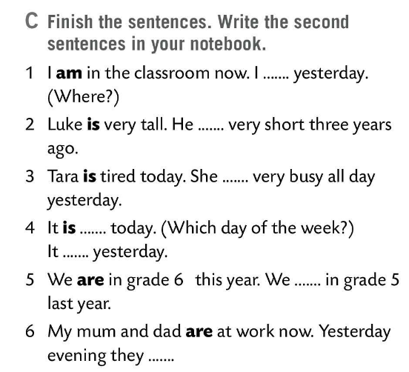
Finish the sentences in Task C.
Write the second sentences in your notebook. Use past simple of the verb ‘to be’.
was …
was
was
Check.
was …
were
were…

Slide 6
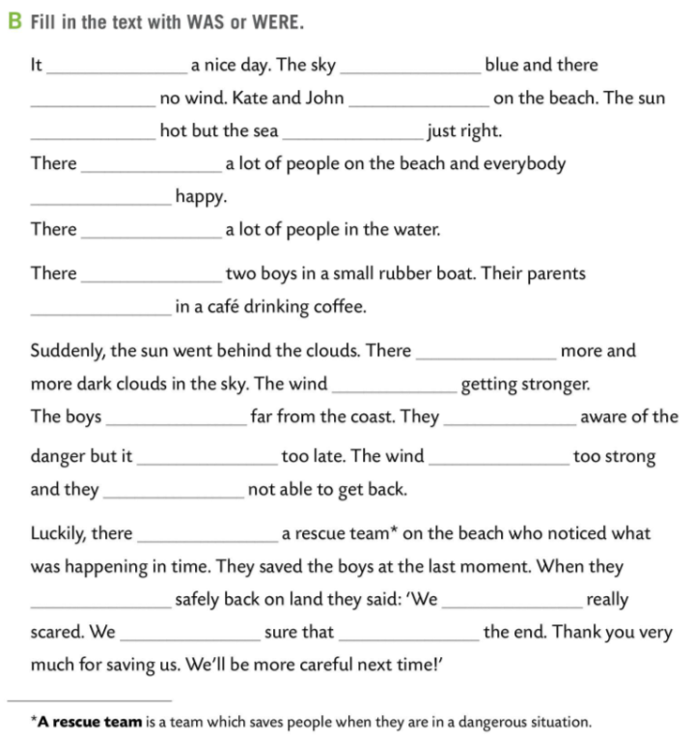
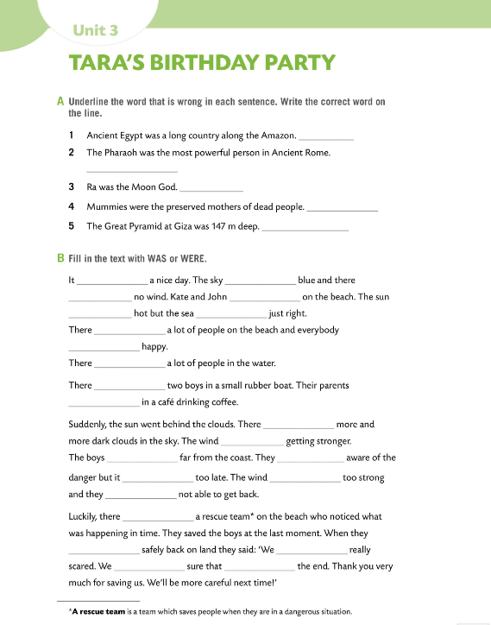

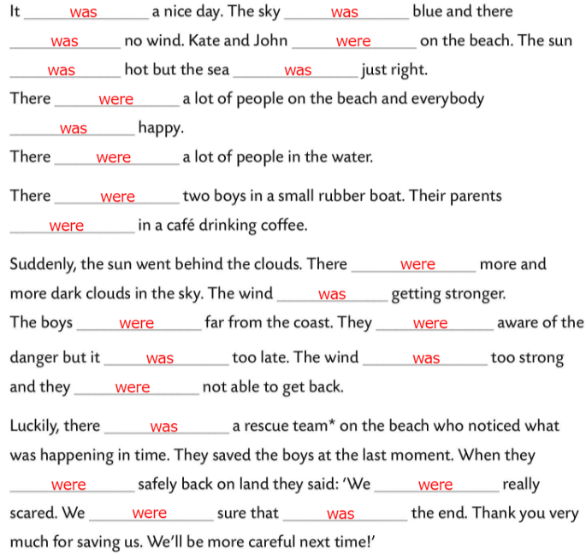
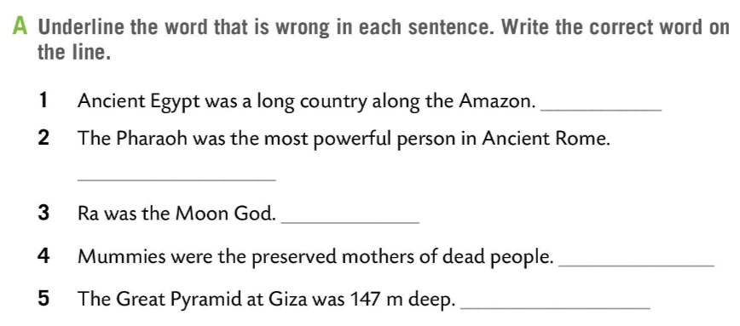
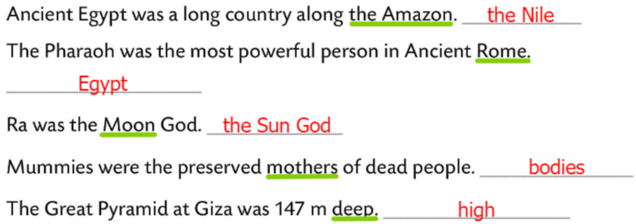
Workbook, page 60.
Underline the word that is wrong in each sentence. Write the correct word on the line in Task A.
Check.
Fill in the text with WAS or WERE.
Check.

Slide 7
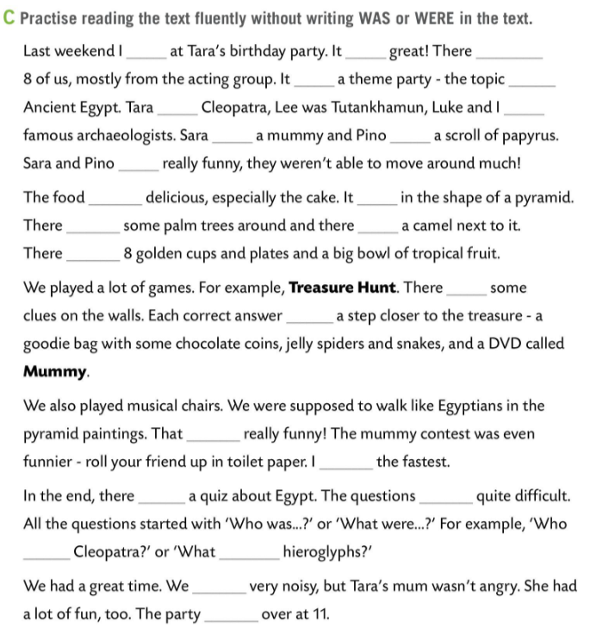
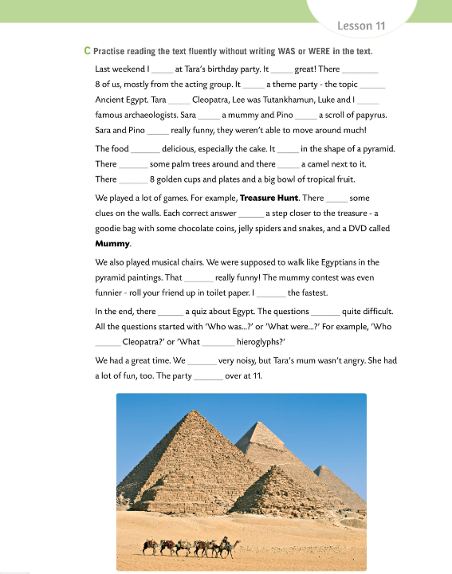
Workbook, page 61.
was
was
were
Do task C.
Practise reading the text fluently without writing WAS or WERE in the text.
Fill in the text with WAS or WERE.
was
was
was
were
was
was
were
was
was
were
was
were
were
was
Check.
was
was
was
were
was
were
were
was

Slide 8
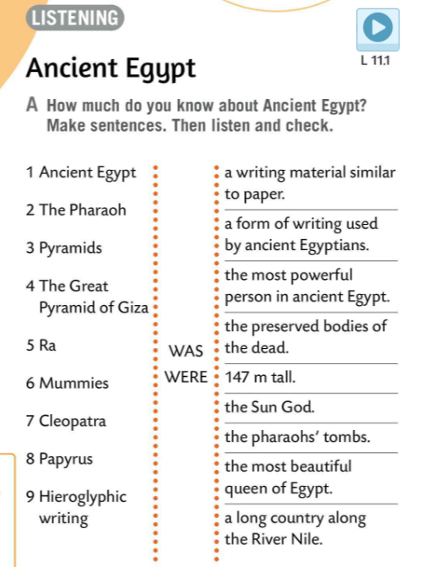

How much do you know about Ancient Egypt?
Make sentences in Task A.
Listen and check.
1 Ancient Egypt was a long country along the River Nile.
2 The Pharaoh was the most powerful person in ancient Egypt.
3 Pyramids were the pharaoh’s tombs.
4 The Great Pyramid of Giza was 147 m tall.
5 Ra was the Sun God.
6 Mummies were the preserved bodies of the dead.
7 Cleopatra was the most beautiful queen of Egypt.
8 Papyrus was a writing material similar to paper.
9 Hieroglyphic writing was a form of writing used by ancient Egyptians.

Slide 9
Look at the words and repeat them after your teacher.
ancient – drevni
pharaoh – faraon
pyramids – piramide
preserved – očuvano
tombs – grobnice
hieroglyphic writing – hijeroglifsko pismo

Slide 10
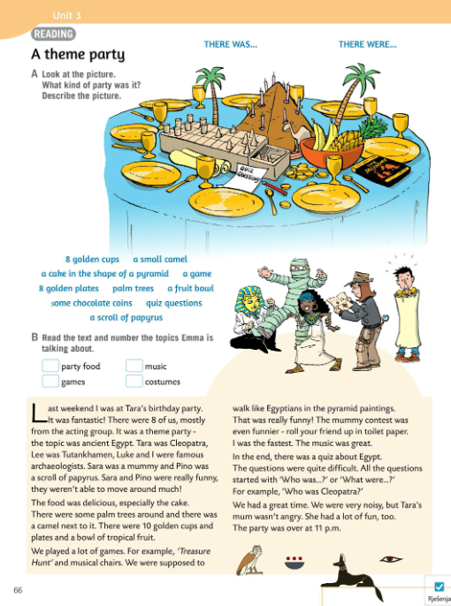
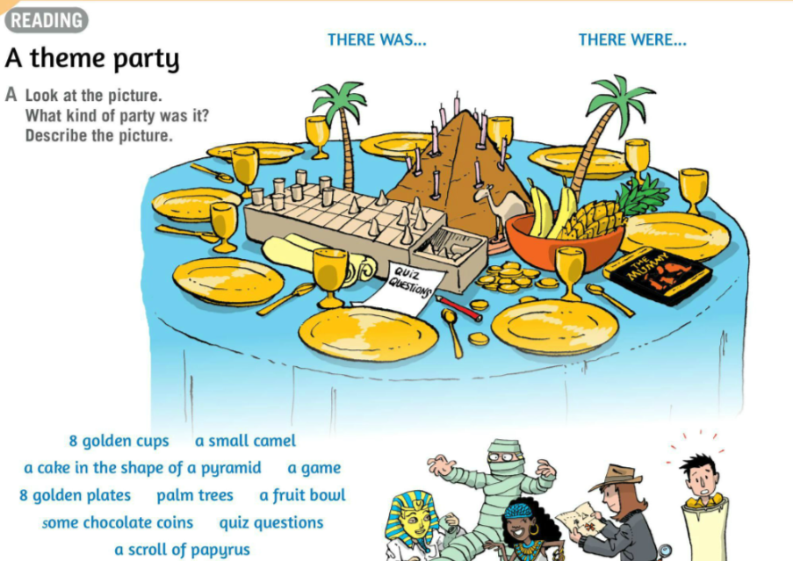
Look at the picture in Task A.
What kind of party was it? Describe the picture.
It was an Egyptian Theme Party.
There were 8 golden cups.
There was a small camel.
There was a cake in the shape of a pyramid.
There were games.
There were 8 golden plates.
There were palm trees.
There was a fruit bowl.
There were some chocolate coins.
There were quiz questions.
There was a scroll of papyrus.

Slide 11
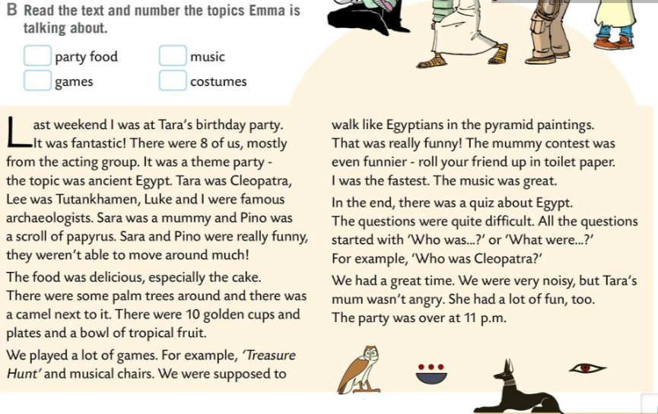
Read the text and number the topics Emma is talking about.
Check.
2
4
Translate:
cup – čaša, pehar
camel – deva
plate – tanjur
palm trees – palme
bowl – zdjela
coin – kovanica, novčić
scroll – svitak
theme party – tematska zabava
3
1

Slide 12
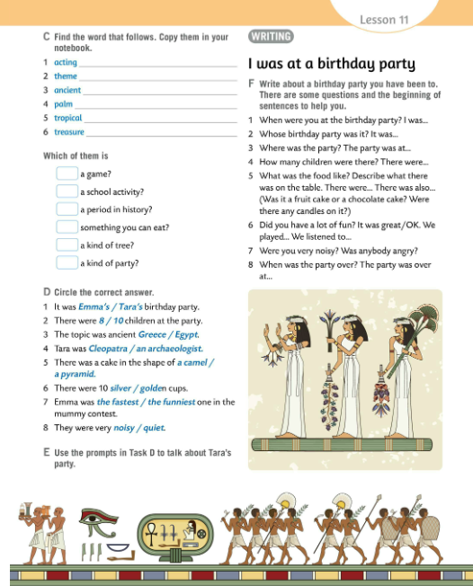
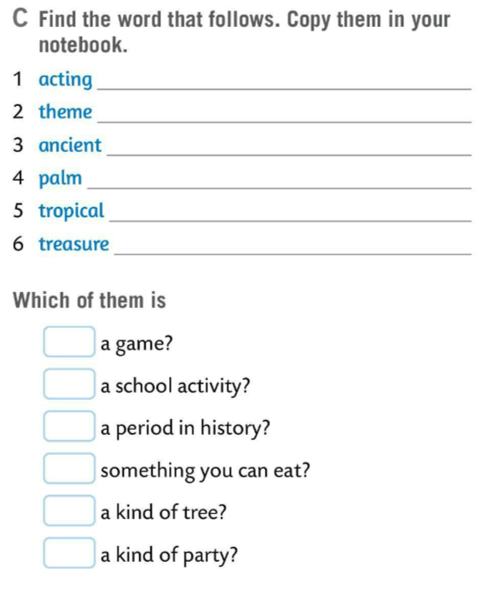
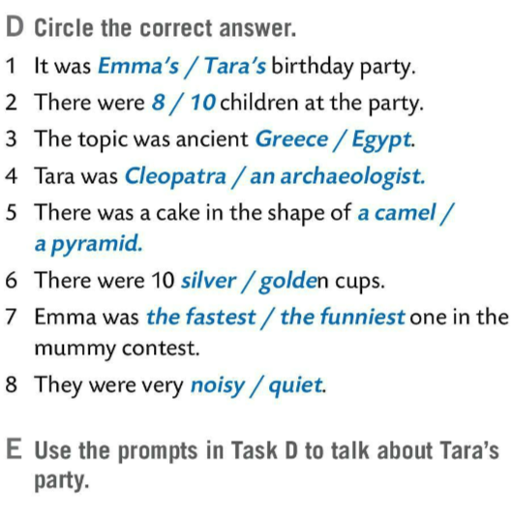

Find the word that follows in Task C.
Check.
group
party
Do you know the meaning of the words from Task C? Use the dictionary to help you.
Egypt
trees
fruit
hunt
Circle the correct answer in Task D.
6
1
Check.
3
5
Use the prompts in Task D to talk about Tara’s party.
4
2

Slide 13
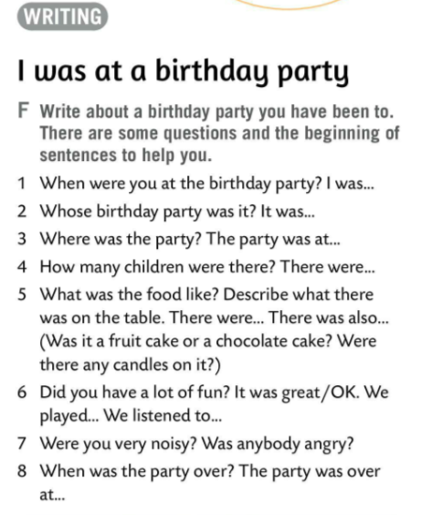
Write about a birthday party you have been to.
There are some questions and the beginning of sentences to help you in Task F.
Share your experience with the rest of the class.
Play the game and check your vocabulary knowledge. Finish the sentences.
https://wordwall.net/play/511/084/634

Slide 14
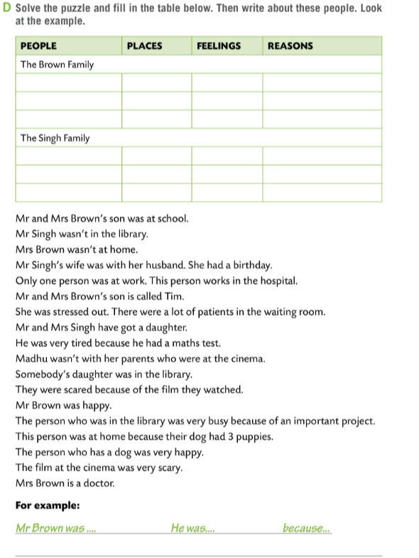
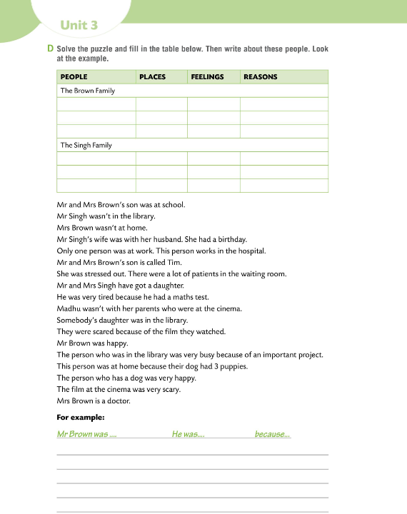
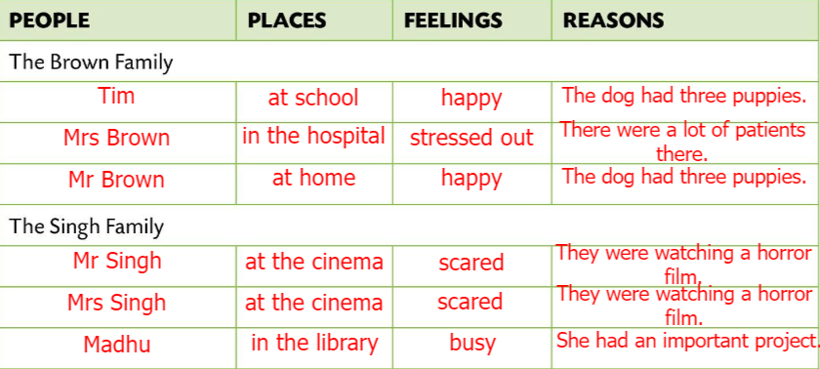
Workbook, page 62.
Solve the puzzle and fill in the table in Task D. Then write about these people. Look at the example.
Check.
Play a game in class.
https://wordwall.net/play/8344/956/925

